Slide 1

A Brief Overview of Black-box Optimization.
John Woodward
jrw@cs.stir.ac.uk
www.cs.stir.ac.uk/~jrw

Slide 2
Roadmap Ahead
Define Optimization
What is/not black box optimization.
Generate-and-test paradigm
Three simple steps. Outline of metaheuristics
*Search space. Objective function. Neighbourhood function*
Three examples (travelling salesman problem, knapsack problem, automatic programming).
Motivation for metaheuristics (and when to use), (hidden) assumption.
Though experiment about nature of meta-heuristics.
Sources of inspiration ☺☹
Evaluation of a meta-heuristic.

Slide 3
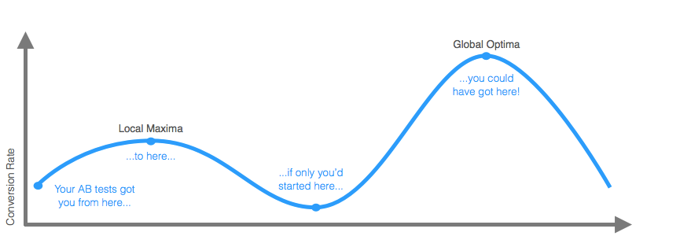
Formalizing an optimization problem
Given a function f : A-> R from some set A to the real numbers (???)
Find an element x₀ in A such that f(x₀) ≤ f(x) for all x in A ("minimization").
Global, local optima.

Slide 4
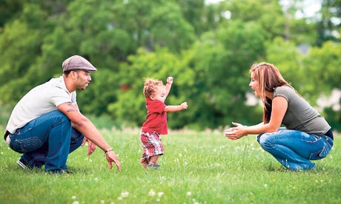

Three easy steps…
How to represent your problem on a digital computer, what constitutes a set of possible solutions.
Define a metric, distinguishing the quality of solutions.
Sample the solutions with a meta-heuristic (you need a neighbourhood function).

Slide 5

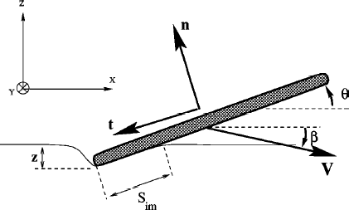
Intention
Not a deep, but skim surface.
Other experts in room.
“Educate” basic terminology
  Search space
  Objective function
  Neighbourhood/function.
  ASK QUESTION AS WE GO

Slide 6
Basic Vocabulary
In/tractable.
Exhaustive search/random search/ combinatoral explosion.
Global optima/local optima/near-optima.
Objective function, search space, neighbourhood function/Operator.
Hill climber, (simulated annealing),
(premature) convergence.(landscape, greedy heuristic )
Metaheuristic (also called search algorithm – not to be confused with text search in word processor, or internet search).

Slide 7
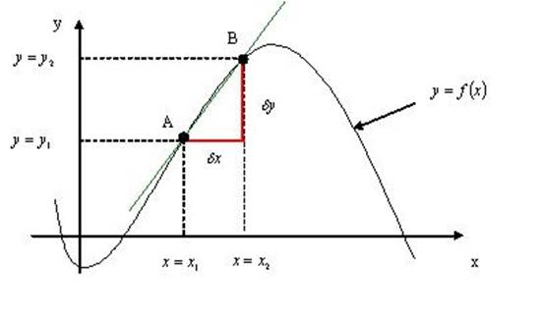
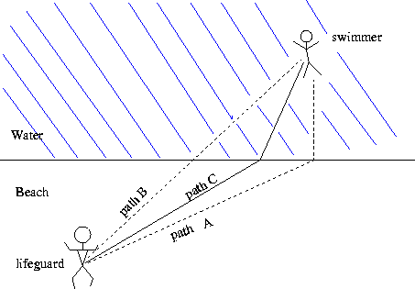
What is/not Black box optimization?
In mathematics
In physics (Calculus of variations)
What is the best x
What is the best path

Slide 8
What is/not Black box optimization?
In mathematics
In physics
We nominate x, and learn f(x)
We nominate a path p and learn time t(p)

Slide 9
Search Space - Representation
A search space is a set of
  Candidate/potential solutions (in/feasible)
In the function example (X)
In the lifeguard example (set of paths, straight or curved (rocks/currents/unknown) – bounds?)
Can be numbers, bit string, permutations, programs, probability distributions, routes, (anything you can represent on a computer)
Also called points, items, elements, vertices, nodes

Slide 10

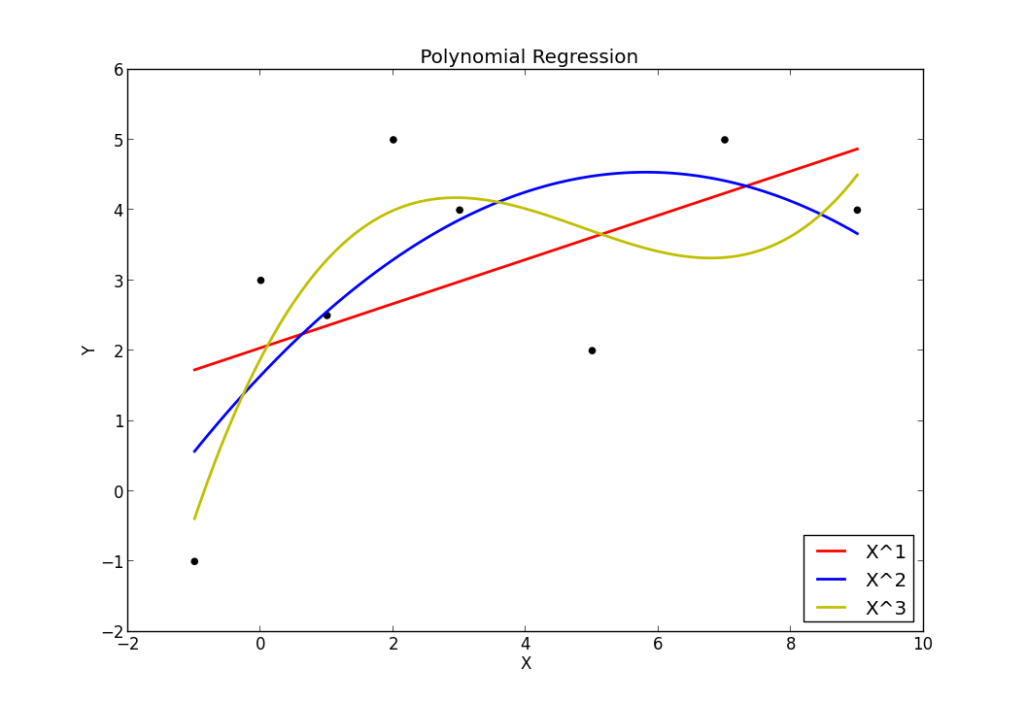
Objective Function
We want to minimize or maximize the objective function. Also called
  Error score (signal processing)
  Fitness function (evolutionary biology)
  Residuals (regression)
  Cost/utility (Economics)
  Energy Function (Physics)
  loss

Slide 11
note
Need to distinguish between objective function and fitness function.
(find slide about kid with dirty feet in bath)

Slide 12
1-100 game
Guess the number between 1 and 100.
Bisection is the best
But what is the person playing makes mistakes (e.g. max 3).
What is they give random answers
(imagine they are 3 separate people. )

Slide 13
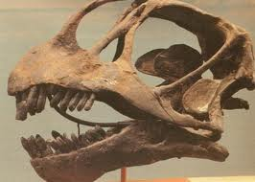
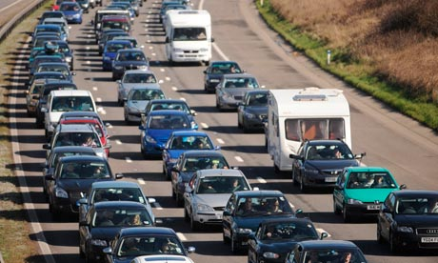
Picking an Objective Function
How to encourage Chinese peasants and farmer to take dinosaur bones to a local museum - answer pay them. BUT ….break bones
How to reduce traffic problem in Beijing – answer restrict car licence plates ending in 0 or 1 not to enter city on Monday and so on.

Slide 14
A better solution
It would be better to pay Chinese farmers the reward for the mass of bone – this would discourage them from breaking the bone into pieces. Or better mass*mass (?)
What about the traffic problem.
The function we use to drive/motivate/encourage maybe different to the final objective function.
What people say and what people do are two different things.

Slide 15
Neighbourhood Function/Operator
N:S -> 2^S, operator : S -> S
The neighbourhood function N takes the current solution s and returns a subset of the search space.
The neighbourhood of a solution s is the set of all solutions “near to it”.
This function is (sometimes) stochastic.
The implicit assumption is neighbouring solutions have similar objective value (this makes some sense).
The greedy algorithm heuristic says to pick whatever is currently the best next step regardless of whether that precludes good steps later.

Slide 16
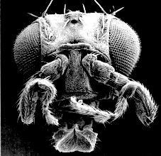
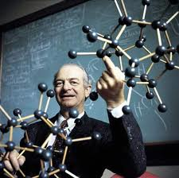
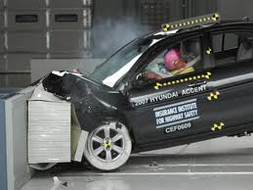
Generate and Test (Search) Examples
Feedback loop
Humans
Computers
Manufacturing e.g. cars
Evolution “survival of the fittest”
“The best way to have a good idea is to have lots of ideas” (Pauling).
Computer code (bugs+specs), Medicines
Scientific Hypotheses, Proofs, …
Generate
Test
Notes:
http://neurophilosophy.wordpress.com/2006/08/09/the-role-of-hox-genes-in-development/
What is wrong with the test and generate method for programs.
GENERALIZE “The best way to have a good idea is to have lots of ideas” (Pauling).

Slide 17
Generate and Test (function optimization)
Generate x. The test/feedback is f(x)
Automating “educated guess”
f(x)
Function to optimize
Meta-
heuristic
x

Slide 18
Informal Example – warm/cold game.
Finding a sweet in a room by getting feedback of warmer/colder. Following variations
One step (hill climb) or step anywhere (random)
Warm cold, but better quality feedback (hot to freezing)
Evil aunt – swaps hot/cold (deceptive function)
Transform function (e.g. hot -> cold) so not uni-modal.
A sweet and a chocolate (sweet is local optima).
As the crow flies distance vs walking distance

Slide 19
3 example problem domains
Travelling salesman problem.
Knapsack.
Genetic programming (automatic program synthesis).
For each of the above we will ask
  What is the representation (search space)
  What is the objective function
  What is a good neighbourhood function.

Slide 20
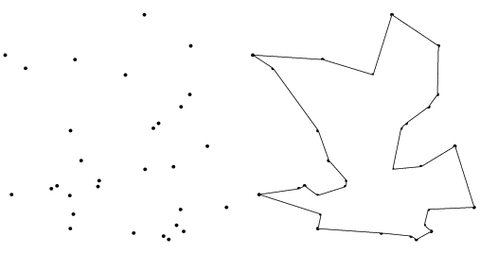
Traveling Salesman Problem
How represent solutions (search space)
What is the objective function
What is the neighbourhood function – any candidates?

Slide 21
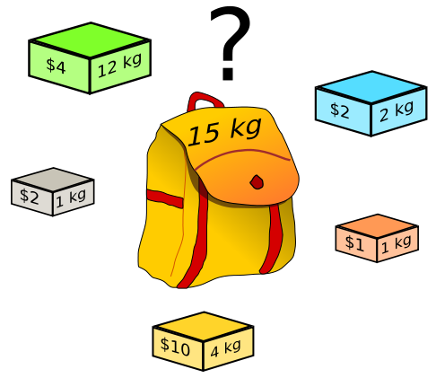
Knapsack Problem
Pack items!!
Solution representation.
Objective function
Neighbourhood function – any candidates?

Slide 22

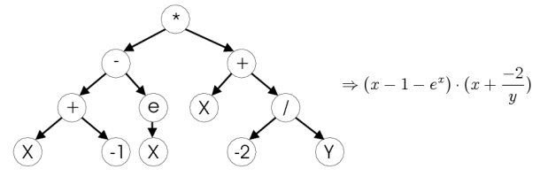
Genetic Programming
Representation (search space)?
Quality measure?
How alter a program?

Slide 23
The three examples
PROBLEM DOMAIN | Quality | Representation | Neighbourhood
Travelling salesman problem | Route length | Permutation | Reverse a sub-tour. Swap two cities.
Knapsack | Value packed | Bit string | Flip bits uniformly at random. Flip a single bit
Genetic Programming | Bugs? Error score, Execution time, energy consumed… | source code/ Tree of instructions. | Add/delete individual instructions. Line of code
Which search spaces have infeasible solutions?

Slide 24
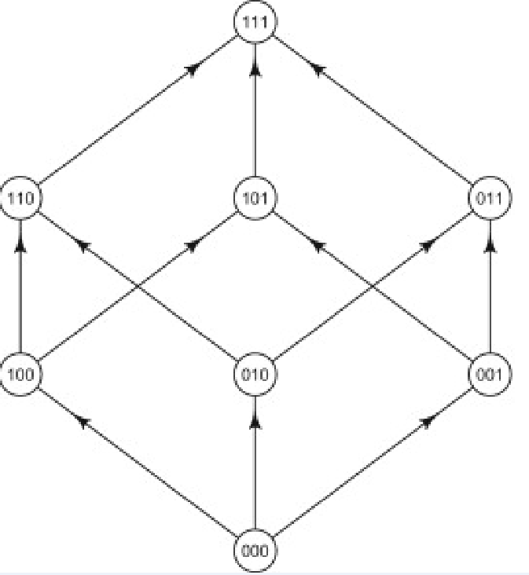
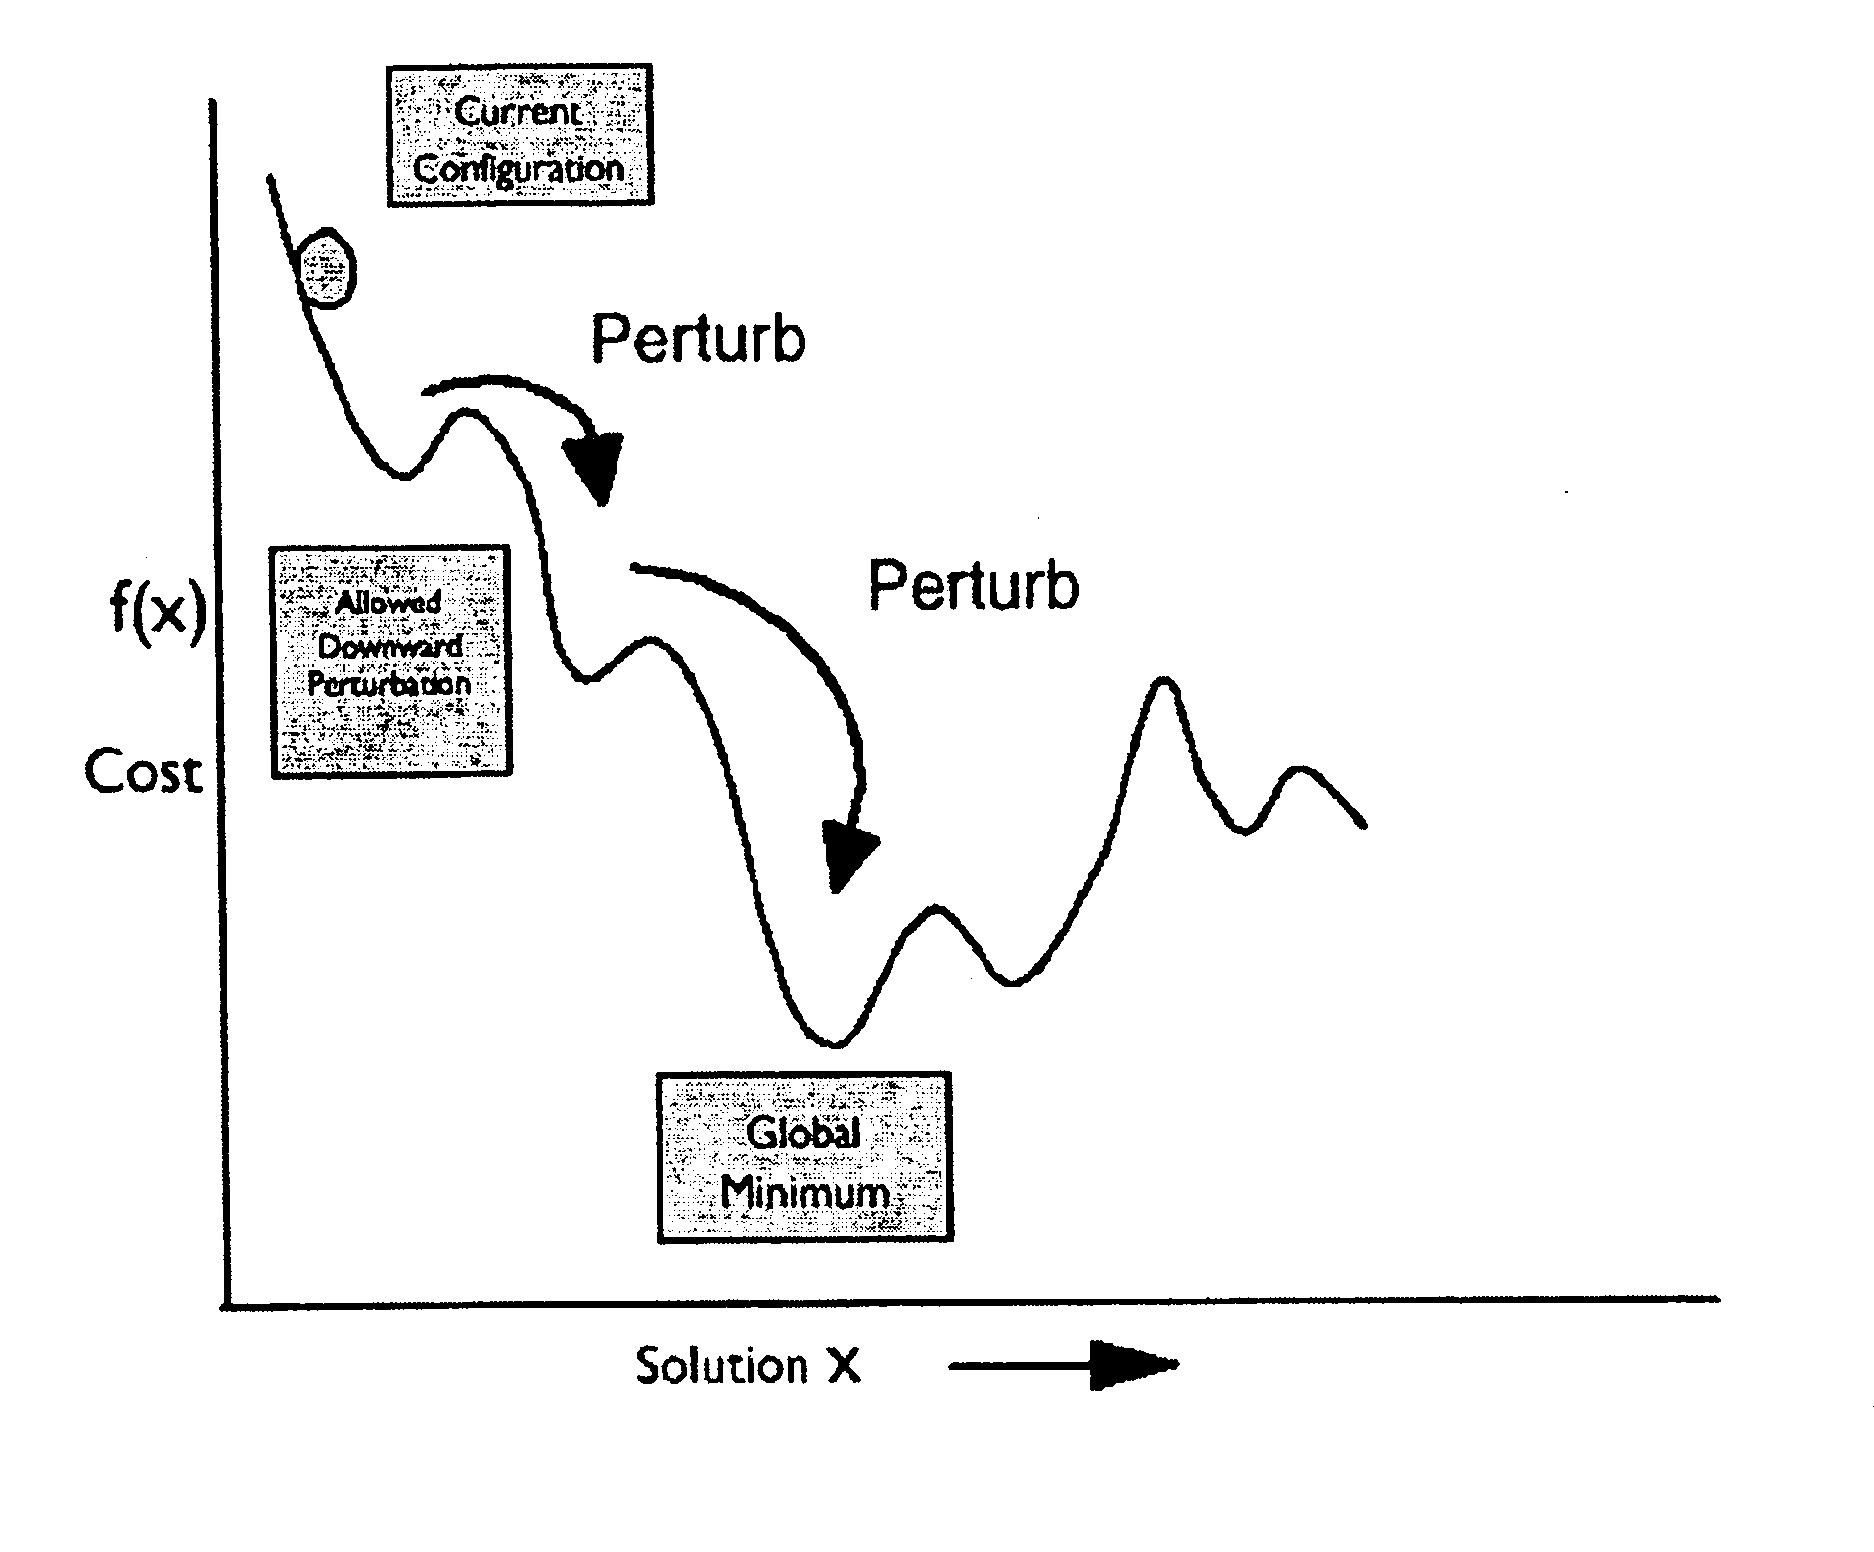
Perturbing a Solution
3 bits (binary/Gray code)
Operator – flip one bit
Size of space |S| = 8
Neighbourhood size = 3.
Neighbourhood is often drawn as on right.
Give example of timetable.
A global optima is independent of the neighbourhood function.

Slide 25
Iterative Improvement
Stirling CS timetabling ☹
About 6 hours, under 10 (EPSRC guidelines)
(HARD) All labs have correct number of phd students.
(SOFT) students earn same amount of cash.
The “Savi Maharaj” Heuristic
– allocate “hardest” courses first (e.g. 3rd and 4th year which require specialist knowledge with few volunteering phds students)
– and “easier” course later (e.g. 1st year with many volunteers).
I DID NOT IMPLEMENT THE FOLLOWING METAHEURISTIC

Slide 26
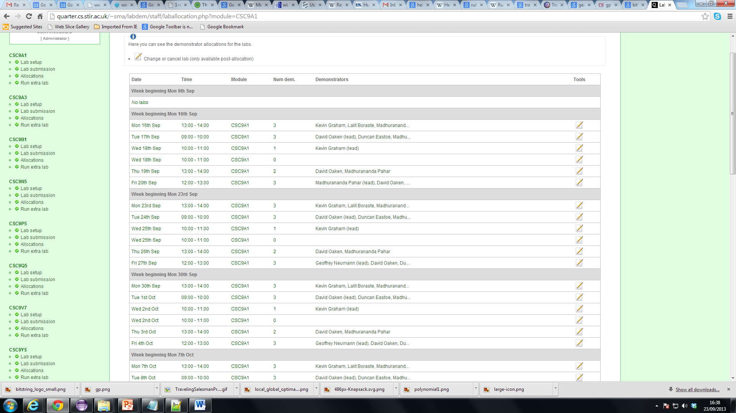
Stirling timetable

Slide 27
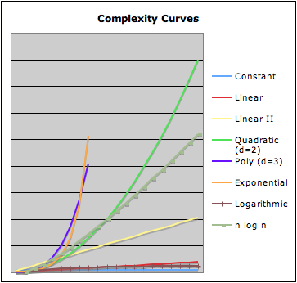
Motivations
Time constraints.
Do not need exact optima
Few assumptions about problem domain
Widely applicable
Easy to implement.
P=NP (negative)

Slide 28
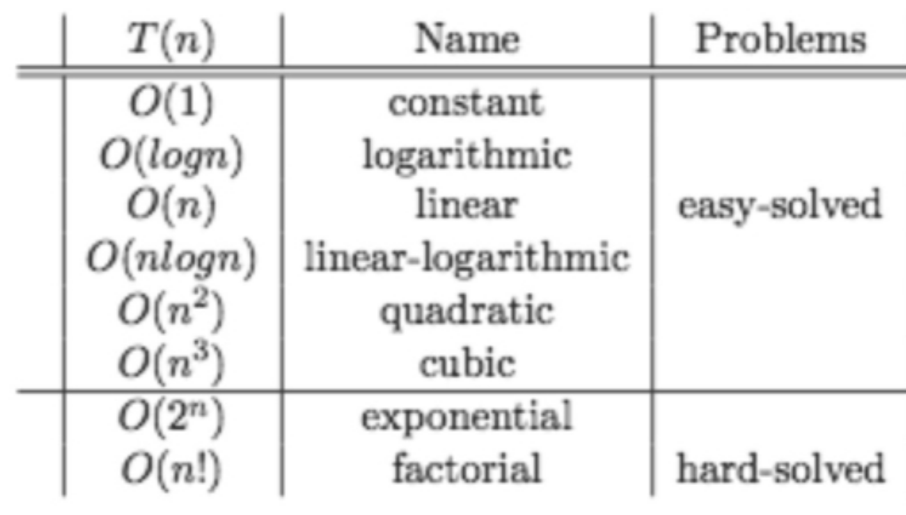
Intractable problems

Slide 29
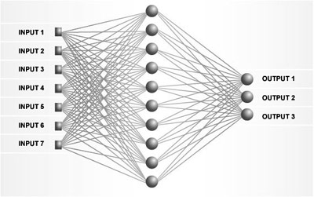
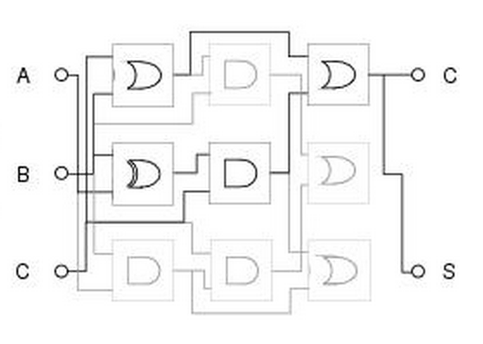
YOUR PROBLEM
You may have a problem domain that easily maps onto already-existing representations/data-structures (e.g. permutation, bit-strings, abstract syntax trees).
However, you many have a problem with a representation which needs more thought (e.g. a 3 layer feed forward artificial neural network – or electrical circuits – directed acyclic graphs), design of steering wheels.

Slide 30
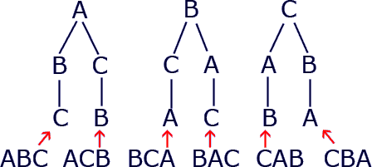
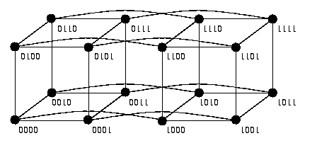
Existing Neighbourhood functions
Permutations. A neighbourhood function that worked well on TSP may not work well on a different permutation problem e.g. regression testing or people-person assignment task.
Bit-strings. An operator that works well on subset sum problem may/not work well on knapsack problem

Slide 31
Hard/Soft Constraints
Timetabling: a hard constraint e.g. a teacher cannot give two lectures at the same time.
A soft constraint e.g. which is better 4 lectures in a row, or two lectures at 9am and two lecture at 5pm (only the domain expert may know this – and even then implicitly).
Airports: hard constraint Two planes cannot land on the same runway at the same time.
soft constraint - is a two hour delay preferable to being rerouted from Heathrow to Gatwick.

Slide 32
Metaheuristics
Informally a heuristic is a “rule of thumb” (approximation to exact rule).
E.g. Totalling up shopping by rounding up/down to nearest pound (central limit theorem???).
achieved by trading optimality, completeness, accuracy, or precision for speed.
A meta-heuristic is just a method of sampling a search space (i.e. an abstract heuristic). Therefore they are just a conditional probability over the search space.
Often biologically/nature inspired – but we should ignore the details of the inspiration. NOT MODELLING
There is nothing “meta” about a metaheuristic.
A better name would have been algorithmic/computational heuristic

Slide 33
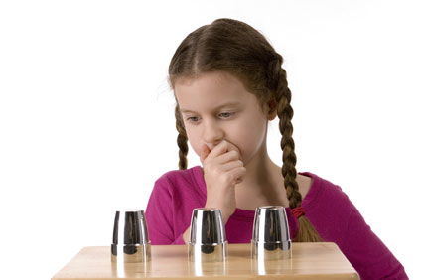
Which cup is the pea under???

Slide 34
Theoretical Motivation 1
Search
Algorithm a
Search
space
Objective
Function f
P (a, f)
x1
x1
x1
1.
2.
3.
X1.
X2.
X3.
Y1.
Y2.
Y3.
SOLUTION
PROBLEM
A search space contains the set of all possible solutions.
An objective function determines the quality of solution.
A search algorithm determines the sampling order (i.e. enumerates i.e. without replacement). It is a (approximate) permutation.
Performance measure P (a, f) depend only on y1, y2, y3
Aim find a solution with a near-optimal objective value using a search algorithm. ANY QUESTIONS BEFORE NEXT SLIDE?
Notes:
Temptation is to just write a search algorithm.

Slide 35

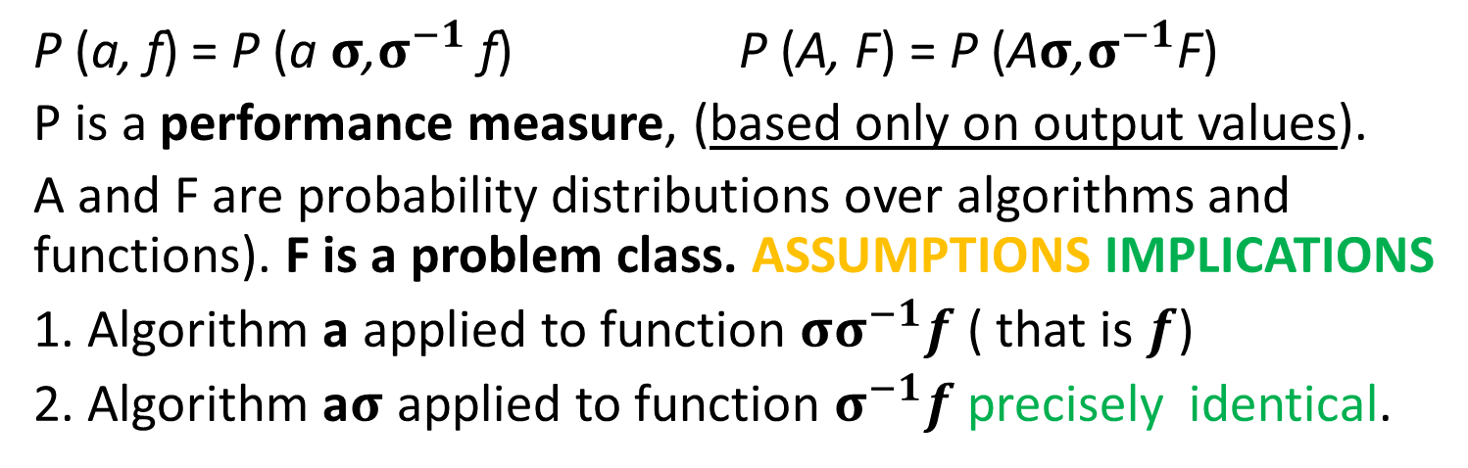
Theoretical Motivation 2
Search
Algorithm a
Search
space
Objective
Function f
σ
x1
x1
x1
x1
x1
1.
2.
3.
1.
2.
3.
1.
2.
3.
1.
2.
3.
1.
2.
3.
Notes:
Not finite, not computable, not all function, not closed under permutation, focussed sets.
Implications. Do not propose a metaheuristic in isolation .
Assumptions - no revisiting, count number of evaluations (ignore execution time. )

Slide 36
Non-exhaustive list of meta-heuristics

Slide 37
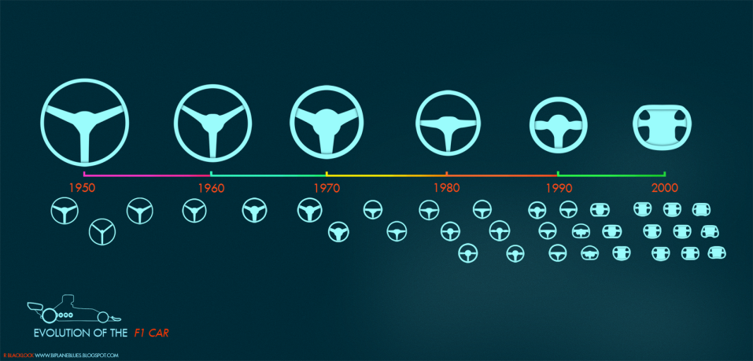
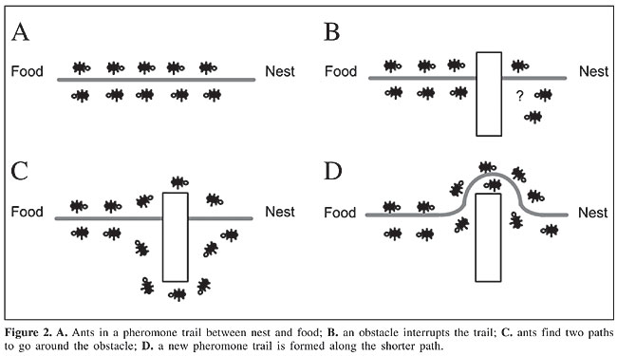
Sources of Inspiration
Evolutionary -> Genetic Algorithms
Ant (find way home) (logistics - synergy)
Simulated Annealing (cooling of metals)
Have I missed any? Yes – the one I use.

Slide 38
Do not mix vocabulary!!!
genotype, phenotype, Allele, gene, chromosome. (EVOLUTIONARY Computation)
These are terms from the domain of inspiration (biology in this case)
Do not mix with vocabulary of the domain you are trying to solve e.g. timetabling (teachers, rooms, students, courses), search based software engineering (test case, program, metric).

Slide 39
How do we sample a search space?
Problem types Metaheuristic | Unimodal | multimodal | Random or Incompressible
Hill climb – accept best neighbour | ???
Random sampling
Evolution - GA
Go thru 6 types
ask two separate groups (non/experts)

Slide 40
Question How do we sample a search space?
Randomly?
Enumeration?
Simulated Annealing?
Bio-inspired?

Slide 41
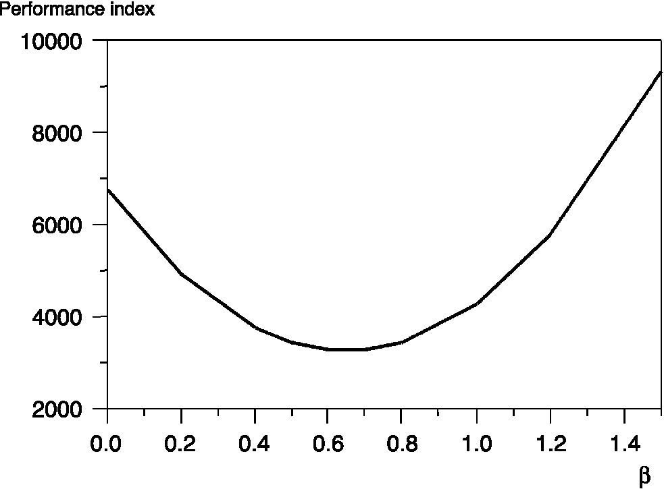
How do we sample a search space?
Randomly?
Enumeration?
Simulated Annealing?
Bio-inspired?
It depends, if the space has a high probability of
Random (incompressible)?
Has a known property?
Is unimodal?
???
Todo add pic of multimodal function.

Slide 42
When not/to use a Meta-heuristic
Meta-heuristics are typically stochastic so may give a different solution each time (this may/not be acceptable in your domain e.g. customer satisfaction – prefer reliability over quality-car park and honey bees).
Typically used when an exact method would take too long to execute.
The search space is too large to examine exhaustively.
Others?

Slide 43
Assumptions
Do not assume the problem is differentiable or continuous, or convex (unimodal).
There is always(!) an implicit assumption within a metaheuristic. Typically that sampling neighbouring solutions is better than non-local sampling (i.e. random search).
Problem with meta-heuristics is they are stochastic so give different answers to same problem!!!

Slide 44
Continuous optimization on a computer
We often distinguish between combinatorial problems (e.g. knapsack and travelling salesman problem) and continuous optimization problems (e.g. continuous function optimization).
Does this distinction make sense when implemented on a digital computer???

Slide 45
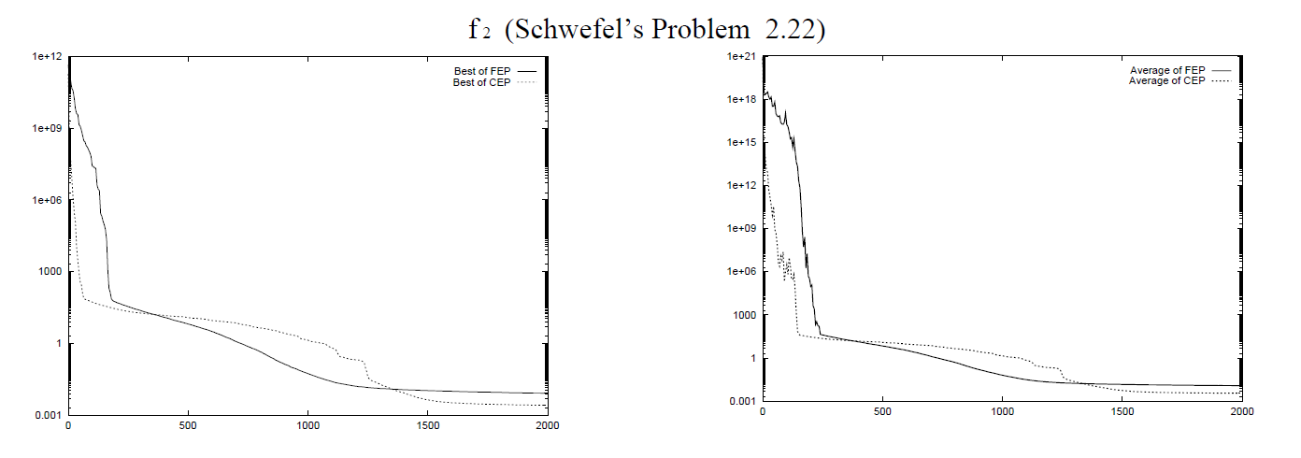
Which meta-heuristic is better.
It depend on when we terminate.
In reality, when do we terminate?
Maximum number of evaluations or within certain tolerance.

Slide 46
Evaluation of Meta-heuristics
How do we evaluate meta-heuristics?
On a set of benchmark problem instances.
Fix the number of evaluations and compare on the quality of the solutions obtained (done repeatedly as it is a stochastic process)
The central assumption is that the test instances are “similar” to the problems you want to tackle in the real world.
Given a problem instance, how do we select the correct/best metaheuristic for it?

Slide 47
Automatic Design of Meta-heuristics
These outperform heuristics in the current literature.
This effect is not due to “publication bias” where only better results are published.
It is a truth, with theoretical underpinning.

Slide 48
A Simple Thought Experiment 1
Global optima
probability
Two distributions
from two sets of runs
Search space

Slide 49
A Simple Thought Experiment 2
Global optima
probability
Two distributions
from two sets of runs
Search space
Meta-bias
Global optima
probability
Search space

Slide 50
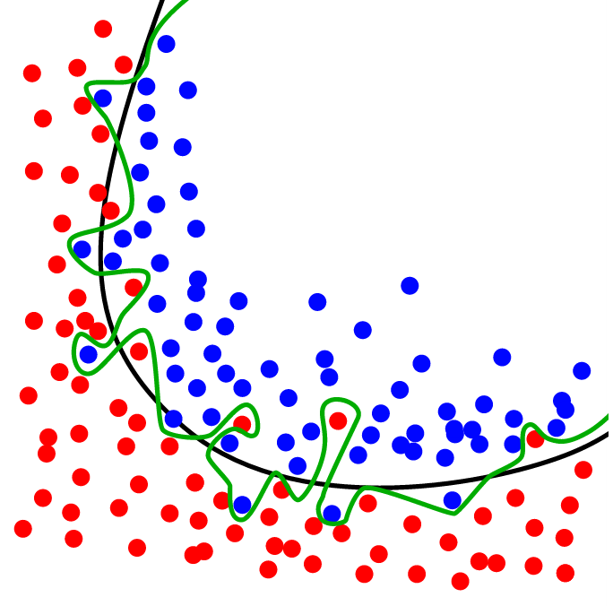
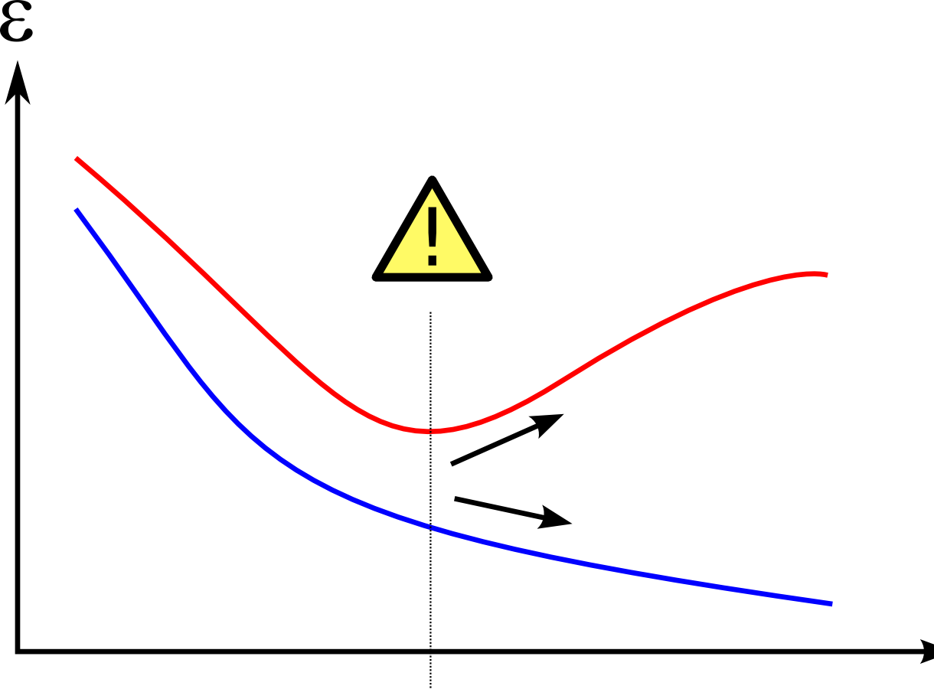
Optimisation = Machine Learning?
There are similarities.
The termination criteria are different.
With optimization we can continue sampling the search space.
With machine learning, if we over sample we over fit the function (learn noise).

Slide 51
We have not mentioned…
Multi-objective optimization (can make single objective as a linear weighted sum – NO!! )
Stochastic optimization
Dynamic optimization
multimodal optimization deals with Optimization (mathematics) tasks that involve finding all or most of the multiple solutions (as opposed to a single best solution).
Infeasible solution – give values –infinity – NO!!

Slide 52
Open Questions
How to select the best meta-heuristic for the task at hand.
How to move thru the search space.
How to design new operators.
Parallel computation.

Slide 53
SUMMARY Sampling a search space
Search space
Objective Function f
x1
x1
Metaheuristic
X1.
X2.
X3.
Y1.
Y2.
Y3.
A search space contains the set of solutions.
An objective function determines the solution quality.
A meta-heuristic samples the search space using a neighbourhood function.
The purpose of a metaheuristic is to decide what subset of the search space to sample.
Notes:
Temptation is to just write a search algorithm.

Slide 54
NOT THE END, BUT
To be continued…
Thank you for listening/not sleeping
Any questions/comments/suggestions
jrw@cs.stir.ac.uk
www.cs.stir.ac.uk
CHORDS group@stirling.

Slide 57
Branch and Bound Algorithm
an “enumeration” of all candidate solutions, solutions are built incrementally.
subsets of candidates can be discarded, using upper and lower bounds.
This requires some knowledge of how the objective function behaves (properties).
Example are TSP and knapsack – we know when to “bail-out” of a poor set of solution and effectively discard that subset.

Slide 58
Person-Task Problem
4 people {A,B,C,D} and 4 tasks {1,2,3,4}
The table below shows the number of minutes for each person to complete each task.
Each person does one task.
Each task needs an assigned a person.
Minimize total time taken.
How do we assign people to tasks?
E.g. ACDB =9+1+2+6 = 18 minutes in total.
 | Task 1 | Task 2 | Task 3 | Task 4
Person A | 9 | 5 | 4 | 5
Person B | 4 | 3 | 5 | 6
Person C | 3 | 1 | 3 | 2
Person D | 2 | 4 | 2 | 6
Notes:
Each person can do one task.
Each task must have an assigned person.
How many tasks are there 4! = 24
If person C does task 4, it take 2 minutes.
ACDB =9+1+2+6

Slide 59
Example of Bounding Function
Example, calculate best value given partial assignment A???
(A does task 1, other tasks are not yet assigned)?
The cost of assigning person A to task 1 is 9 minutes
Best unassigned person for
2 is C (1), 3 is D (2), 4 is C (2) in (minutes)
Note that C is assigned twice!
Total time = (9+1+2+2) = 14 minutes.
We want to minimize so the bounding function is an underestimate.
Notes:
This is an optimistic solution ie. We cannot use person C twice – but gives us a bound.

Slide 60
Branch and Bound Stage 1
Task 0
Task 1
Task 2
Task 3
Incumbent
(best
complete)
solution
None yet.
 | 1 | 2 | 3 | 4
A | 9 | 5 | 4 | 5
B | 4 | 3 | 5 | 6
C | 3 | 1 | 3 | 2
D | 2 | 4 | 2 | 6
PRUNED
FEASIBLE
PRUNED &
FESIBLE
Notes:
Bold means. ??/
Incumbent solution is the best complete solution found so far.
Best in our case mean lowest.
The incumbent solution is for comparison purposes.
There may not be an incumbent solution when the process begins.
DCDC is the fastest possible solution – using people twice.
This is the fastest possible
Time in which we can complete the task.
However it uses people twice.
Therefore is not feasible and is not the incumbent

Slide 61
Branch and Bound Stage 2
Task 0
Task 1
Task 2
Task 3
Incumbent
(best
complete)
solution
CBDA = 13
ACDC=14
Pruned as > 13
 | 1 | 2 | 3 | 4
A | 9 | 5 | 4 | 5
B | 4 | 3 | 5 | 6
C | 3 | 1 | 3 | 2
D | 2 | 4 | 2 | 6
BCDC=9
promising
CBDA=13
Feasible so is1st incumbent. There is no
point growing this node any more.
PRUNED
DCCC=8
promising
FEASIBLE
PRUNED &
FESIBLE
Notes:
Bold means. ??/
Incumbent solution is the best complete solution found so far.
Best in our case mean lowest.
The incumbent solution is for comparison purposes.
There may not be an incumbent solution when the process begins.

Slide 62
Branch and Bound Stage 3
Task 0
Task 1
Task 2
Task 3
Incumbent
(best
complete)
solution
CBDA = 13
ACDC=14
 | 1 | 2 | 3 | 4
A | 9 | 5 | 4 | 5
B | 4 | 3 | 5 | 6
C | 3 | 1 | 3 | 2
D | 2 | 4 | 2 | 6
BCDC=9
CBDA=13
DACC=12
No new
feasible
solutions,
therefore
no new
incumbent
PRUNED
DCCC=8
DBCC=10
FEASIBLE
PRUNED &
FESIBLE
DCAA=12
Notes:
Non of these 3 are feasible therefore there is no new incumbent.
Bold means. ??/
Incumbent solution is the best complete solution found so far.
Best in our case mean lowest.
The incumbent solution is for comparison purposes.
There may not be an incumbent solution when the process begins.
NEXT EXPAND NODE WITH VALUE OF 9

Slide 63
Branch and Bound Stage 4
Task 0
Task 1
Task 2
Task 3
Incumbent
(best
complete)
solution
BCDA = 12
ACDC=14
BADC=13
 | 1 | 2 | 3 | 4
A | 9 | 5 | 4 | 5
B | 4 | 3 | 5 | 6
C | 3 | 1 | 3 | 2
D | 2 | 4 | 2 | 6
BCDC=9
BCDA=12
Feasible but
Pruned as > 12
BDCC=13
CBDA=13
DACC=12
Pruned as > 12
PRUNED
DCCC=8
DBCC=10
promising
FEASIBLE
PRUNED &
FESIBLE
DCAA=12
Pruned as > 12
Notes:
Bold means. ??/
Incumbent solution is the best complete solution found so far.
Best in our case mean lowest.
The incumbent solution is for comparison purposes.
There may not be an incumbent solution when the process begins.

Slide 64
Branch and Bound Stage 5
Task 0
Task 1
Task 2
Task 3
Incumbent
(best
complete)
solution
DBAC = 11
ACDC=14
BADC=13
 | 1 | 2 | 3 | 4
A | 9 | 5 | 4 | 5
B | 4 | 3 | 5 | 6
C | 3 | 1 | 3 | 2
D | 2 | 4 | 2 | 6
BCDC=9
BCDA=12
Pruned
BDCC=13
CBDA=13
DACC=12
DBAC=11
PRUNED
DCCC=8
DBCC=10
FEASIBLE
PRUNED &
FESIBLE
DBCA=13
DCAA=12
Notes:
Bold means. ??/
Incumbent solution is the best complete solution found so far.
Best in our case mean lowest.
The incumbent solution is for comparison purposes.
There may not be an incumbent solution when the process begins.

Slide 65
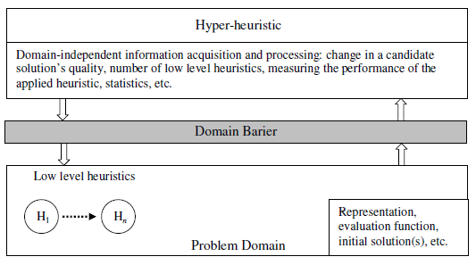
Selective Hyper-heuristics
(massaging problem state)

Slide 66
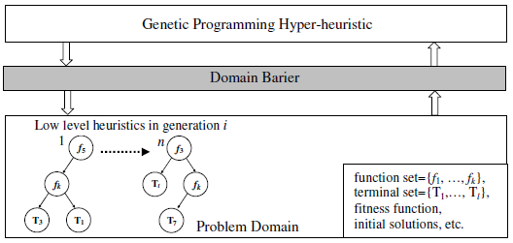
Generative Hyper-heuristics discovering novel heuristics

Slide 67
On-line Bin Packing
A sequence of pieces is to be packing into as few a bins or containers as possible.
Bin size is 150 units, pieces uniformly distributed between 20-100.
Different to the off-line bin packing problem where the set of pieces to be packed is available for inspection at the start.
The “best fit” heuristic, puts the current piece in the space it fits best (leaving least slack). It has the property that this heuristic does not open a new bin unless it is forced to.
Array of bins
Range of
piece size
20-100
150 =
Bin
capacity
Pieces packed so far
Sequence of pieces to be packed

Slide 68
Genetic Programming applied to on-line bin packing
Not immediately obvious how to link
Genetic Programming to apply
to combinatorial problems.
See previous paper.
The GP tree is applied to each
bin with the current piece
put in the bin which
gets maximum score
capacity
emptiness
Fullness is
irrelevant
The space is
important
Terminals supplied to Genetic Programming
Initial representation {C, F, S}
Replaced with {E, S}, E=C-F
We can possibly reduce this to one variable!!
fullness
size
size

Slide 69
How the heuristics are applied
%
C
-
C
+
-15
-3.75
3
4.29
1.88
S
F
70
120
85
70
90
60
45
30
30

Slide 70
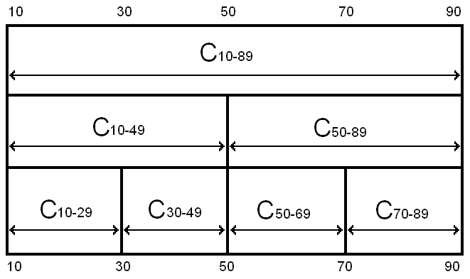
Robustness of Heuristics
= all legal results
= some illegal results
Notes:
Even though the problem is the same, and the hard constraints are the same, the heuristics can fail to stay within the hard constraints if they are asked to pack piece sizes they have not seen before
The safeguards against giving illegal solutions that work in one class will not work in another

Slide 71
The Best Fit Heuristic
Best fit = 1/(E-S). Point out features.
Pieces of size S, which fit well into the space remaining E, score well.
Best fit applied produces a set of points on the surface,
The bin corresponding to the maximum score is picked.
emptiness
Piece size

Slide 72
Our best heuristic.
Similar shape to best fit – but curls up in one corner.
Note that this is rotated, relative to previous slide.

